Slide 1
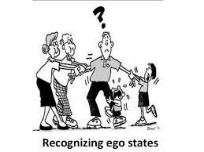
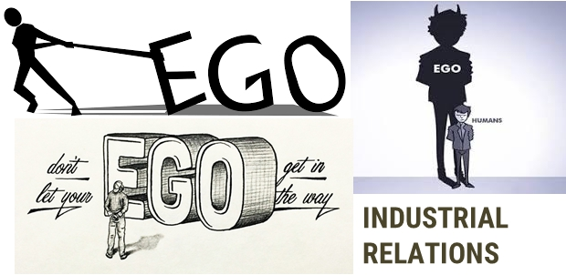
EGO STATES
Dr. Srinibash Dash
School of Management
GMU, SBP

Slide 2
DEFINITION
Ego States are consistent patterns of feeling, thinking and behaviour that we all possess.
It is a way in which we think, feel and behave, making up our personality at a given time.
Eric Berne, a Psychiatrist and the creator of the transactional analysis of ego states, defines Ego state as ‘a system of feelings accompanied by related set of behaviour patterns.’

Slide 3
ANALYSIS OF EGO STATES
The ego plays an important role in human behavior.
Transactional Analysis of Ego state was developed during the 1960s by Dr Eric Berne.
It is based on two notions: That we have three sides or 'ego-states' to our 'personality (Parent, Adult and Child), and that these ego states converse with one another in 'transactions' both internally and externally with other people.
Transactional Analysis helps us understand how we relate to others and gives us useful tools for self-knowledge and personal development.

Slide 4
Structural model of THE EGO STATES
PARENT
ADULT
CHILD

Slide 5
PARENT EGO
Rooted in the past.
Contains the attitudes, feelings, and behaviour incorporated from our parents and caretakers.
There are two types of parent:-
Nurturing parent: Caring, loving, helping.
Controlling parent: Criticizing, reprimanding, censoring, punishing, etc.
The characteristics of parent ego include judgemental, over protective, rule maker, distant, opinionated, value driven, sincere, indispensable, moralizing.

Slide 6
ADULT EGO
Rooted in the present.
The Adult ego state is authentic, direct, reality based, fact seeking and problem solving.
The Adult ego state is the 'grown up' rational person who talks reasonably and assertively, neither trying to control nor reacting aggressively towards others. The Adult is comfortable with him/herself and is, for many of us, our 'ideal self'.
People with adult ego, state, gather relevant information, carefully analyse it, generate alternatives and make logical choices.
The characteristics of adult ego include spontaneous, aware, capacity for intimacy, deals with reality, updates the parent data, never make assumptions and asks for information.

Slide 7
CHILD EGO
Rooted in the past.
Contains the thoughts, feelings, and behaviours that we experienced as a child.
There are two types of child:-
Natural child: Affectionate, impulsive, curious, open, loving.
The Little Professor: Intuitive, creative, curious, exploring, manipulative.
Adaptive child: Guilty, afraid, depressed, anxious, envious, prideful, trying to please everyone.
The characteristics of child ego include silent compliance, attention seeking, coyness, giggling and temper tantrums.

Slide 8
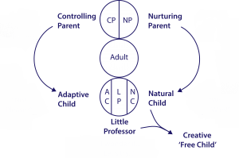
Functional Model of Ego States

Slide 9
CONCLUSION
We all have three ego states programmed with different kinds of behavior.
Awareness of ego states gives more choices in our communication patterns.
THANK YOU

